Slide 1
Callbacks, & Object Review Lab
SEI

Slide 2
Callbacks
SEI

Slide 3
Introduction to Asynchronous
Asynchronous programming is a method of designing code so that it doesn’t block the execution of other tasks while it waits for something.
Actions occur WHEN a particular condition is met.

Slide 4
New Callback: setTimeout()
setTimeout(functionName,delay);
call
What to run
When to run
Notes:
TALKING POINTS:
This gets an element with the ID of ga from the DOM. This would RETURN an object, our DOM element, so that we could then manipulate it.

Slide 5
setTimeout in Action
We can delay the execution of the function by using setTimeout. The example will say hello in 4 seconds (4000 microseconds)
function sayHello(){ console.log(“hello!”);
} setTimeout(sayHello, 4000)
Notes:
TEACHING TIPS:
Emphasize that this is another repeated pattern throughout DOM manipulation; GET the thing we want, then SET some aspect of it according to what we want to do with it.

Slide 6
Objects
SEI

Slide 7
Objects
Objects are another type of data in JavaScript. Like arrays they hold multiple pieces of data. Unlike arrays, they use properties instead of keys AND the properties are in no particular order.
let myObject = { ‘fruits’ : [ ‘orange’ , ’apple’ ], ‘veggies’ : [ ‘celery’ , ’carrow’ ] }

Slide 8
Syntax
const produce = {‘fruits’:["banana", "orange", "apple"]}
You make an array using a set of curly brackets.
Inside the brackets, each value must have a property name and value delimited by a colon and separated by a comma.
Object can contain, strings, numbers, booleans, functions, other objects or any of these combined.
Notes:
TALKING POINTS:
Although the example above is three strings, it’s possible to store data of any type in any array — even more arrays! It can also be tricky at first to understand that const doesn’t prevent us from changing the stuff inside the array. We just can’t re-assign the variable to a new value.

Slide 9
Petfinder
SEI

Slide 10
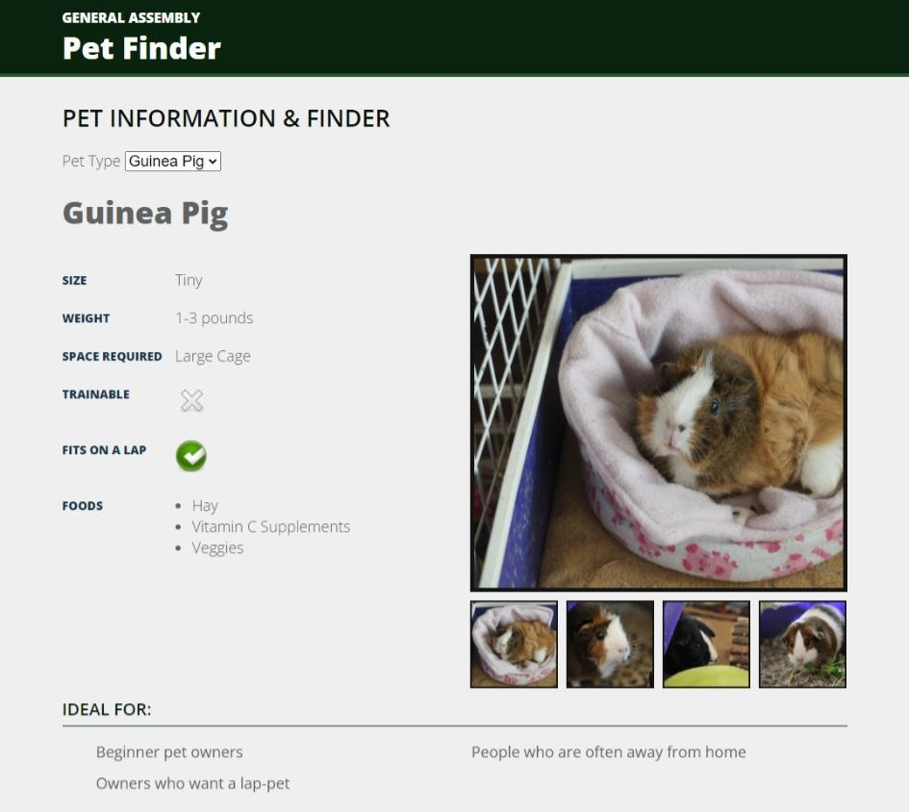
Pet Finder
120 minutes
Today, you’re going to build a page to help users learn about potential pets. To build this page:
Figure out what type of pet has been selected
Loop through all the types of information for that pet type
Output it on the DOM
Note: some types of information may need be transformed from what is in the object.

Slide 11
Pet Finder
Loop through each selected part of the object to create the pet information!
Starter code:
https://drive.google.com/drive/folders/1ECuJBSbGJDlRk5cn1RxwcSR1n4kZSm7-?usp=sharing
Solution code:
https://drive.google.com/drive/folders/1zvil6ku62JpevHjVCCfiThFmWpTvFqv5?usp=sharing

Slide 12
Pet Finder: Encrichment - Ajax
In the previous exercise, we loaded the data from a statically defined object. Instead let’s load it on the fly using ajax!
Solution code:
https://drive.google.com/drive/folders/1Si9WDfKV_iaQ16ga87o0Bx7Lf3Zmo8P2?usp=sharing

